Slide 1
Programming 4 - Intermediate Architecture
and Algorithms
Exam Preparation
Semester 2, 2019
Notes:
In the exam, you will get questions about the following:
Pointers
Linked Lists
Prolog
Inheritance
Finite State Machine (FSM)
Optimization
List comprehensions
Lambda
Iterators and generators
Exceptions
Ruby

Slide 2
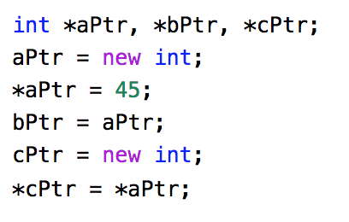
Pointers
What are the values of aPtr, bPtr, cPtr?
What are the values of *aPtr, *bPtr and *cPtr
Notes:
Pointer problems can get complicated, but the logic is always the same
What are the values of aPtr, bPtr, cPtr? => Don’t know, they are memory addresses
What are the values of *aPtr, *bPtr, *cPtr? => All 45
Don’t worry about all the operators – in practice, we don’t use them all that much in Visual C++
What is critical is that you understand that pointers don’t hold the data themselves, they hold the address of the data
Keep clear the difference between the value of a pointer (the address it holds) and the value of the data it points to (what you get when you deference)
When you declare a class instance in C# or Java, the variable is a pointer to the class instance, not the class instance itself. The language allows us to talk to the pointer as though it was the instance. For example, Person John; John->Move(). We think that John is a Person and telling John to move. Actually, John is a pointer to a Person in memory. John just holds an address. John is not a Person.

Slide 3
Linked Lists
Possible questions:
In pseudocode, describe how you would reverse a singly linked list
In pseudocode, describe how you would you delete the middle item in a singly linked list
In pseudocode, describe how you would delete the last item in a singly linked list
In pseudocode, describe how you would insert an item at the tail of a singly linked list

Slide 4
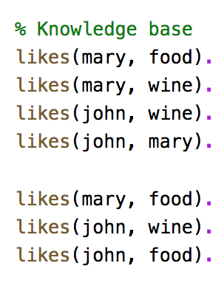
Prolog
What are the results of the following queries?
Does Mary like food?
Does John like wine?
Does John like food?

Slide 5
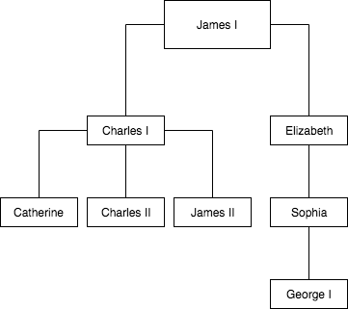
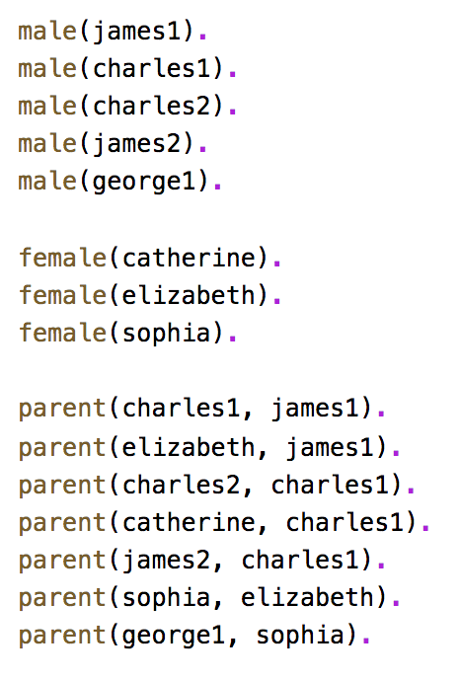
Prolog
How would you create the following queries?
Was George I the parent of Charles I?
Who was Charles I's parent?
Who were the children of Charles I?
(Extra challenge) Express the following rules:
M is the mother of X if she is a parent of X and is female
F is the father of X if he is a parent of X and is male
X is a sibling of Y if they both have the same parent

Slide 6
Inheritance
Draw a UML diagram showing inheritance for the following scenario:
In a University, you have employees and students. Both employees and students have a name, age and sex. An employee has a salary, but a student has a loan, student id and GPA

Slide 7
Finite State Machine (FSM)
When in the Move state, the monster moves in a constant direction
for a fixed number of timer ticks, then selects a new random movement direction.
If it encounters an obstacle, the monster backs up a little, then moves into the
Change Direction state, where it selects a new randomly chosen direction before returning to the Move state. If it encounters food, it enters the Eat state. After entering the Eat state, the creature remains in that state for a fixed number of timer ticks. Its size then increases to allow the viewer to observe the effect of eating.
Sketch a Finite State Machine representing this AI

Slide 8

List comprehensions
Simplify imperative code into a list comprehension
Write a list comprehension that uses double(x) to generate numbers between 0-20 and returns the following list of numbers; [2, 6, 10, 14, 18, 22, 26, 30, 34, 38]

Slide 9
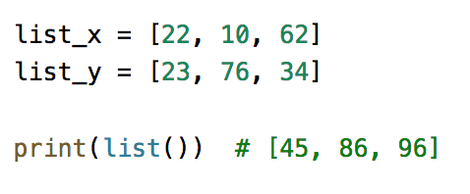
Lambda
Simplify imperative code into a lambda expression
Write a map and lambda function that adds two list of numbers together and returns a single list of numbers

Slide 10
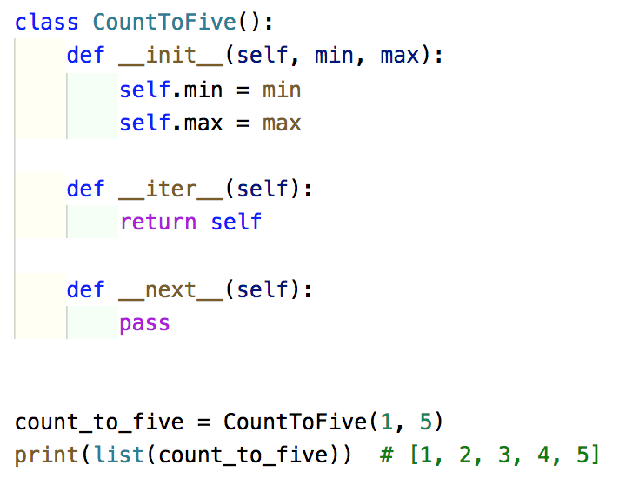
Iterators
What is an iterator?
Write __next__ code to get the desired output

Slide 11
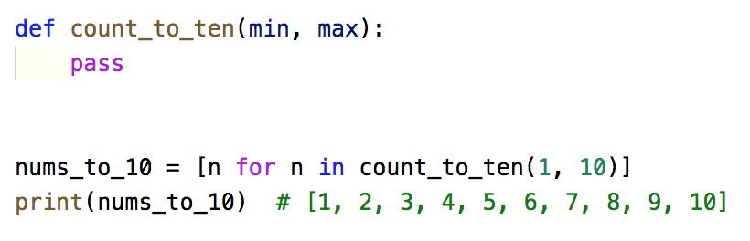
Generators
What is an generator?
Write count_to_ten(min, max) code to get the desired output

Slide 12
Exceptions
Identify common exceptions:
MissingMemberException
OverflowException
StackOverflowException
NotImplementedException
NullReferenceException

Slide 13
Ruby
Answer the Ruby assignment preparation questions

